Slide 1
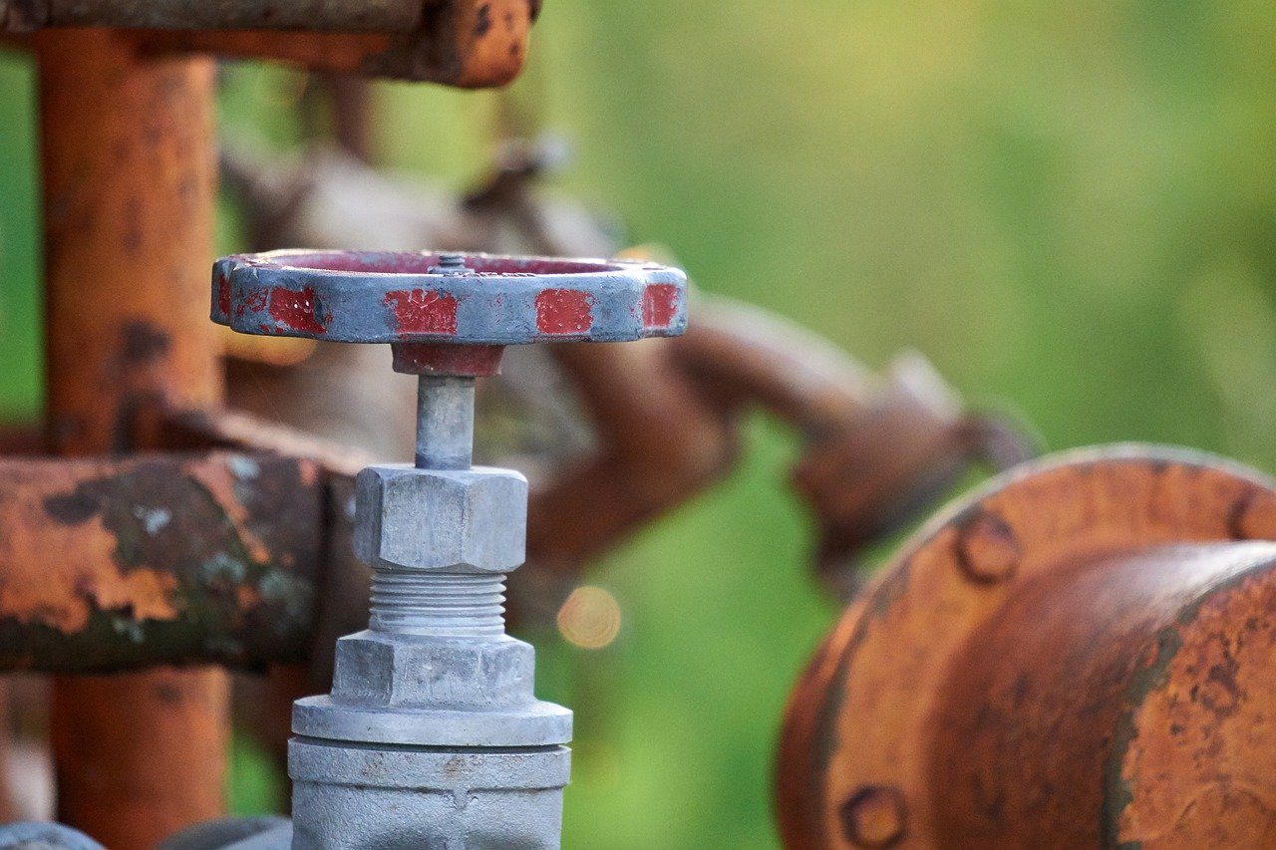

Valves And Fittings
[1]
Group members:
Sandesh, 139
Sandip, 140
Sangita, 141
Sanjay, 142
Sanjeev, 143
Santosh, 144
Tutor:
Asst. Prof. Shukra Raj Paudel
Department Of Civil Engineering
IOE, Tribhuvan University
2019-12-05
[1] : www.pixabay.com

Slide 2
Objectives Of The Presentation
Valves and their types, their working mechanism and function
Various types of fittings and their uses
Purpose and Design of Break Pressure Tank
Public Stand Post, it’s design and past construction practices
Maintenance of Water Supply system and necessary actions
4

Slide 3
Presentation Outline
9.1 Valves
9.2 Fittings
9.3 Break pressure tank
9.4 Public Stand Post
9.4.1 Location
9.4.2 Design
9.4.3 Construction
9.5 Maintenance of water supply system

Slide 4
9.1 Valve
Control and regulate the flow of water
Backflow prevention device
Function of
valve
Release the excessive pressure build up
Release and admit the air
Drain the water from pipeline

Slide 5
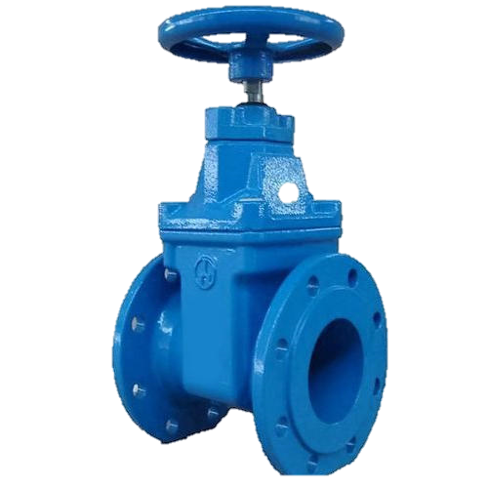
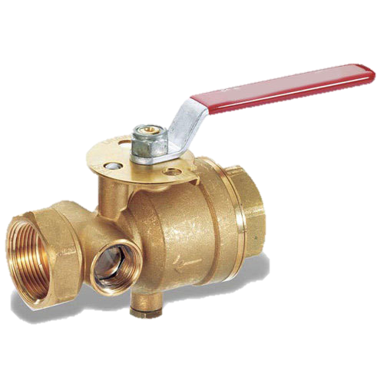
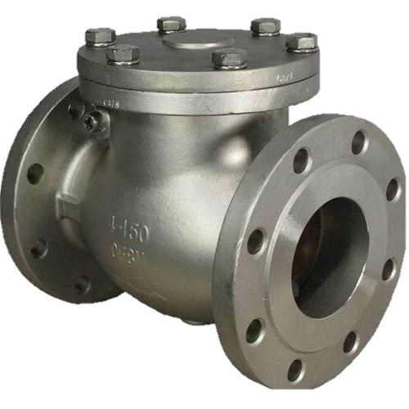
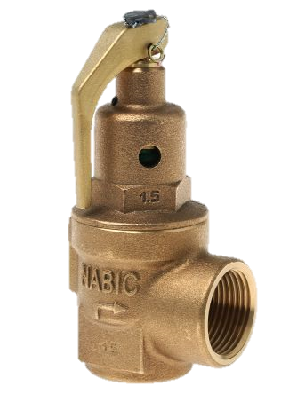
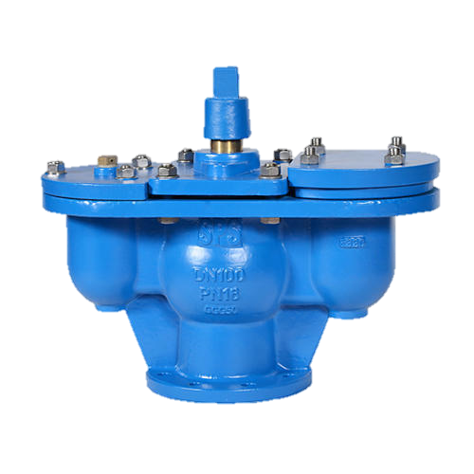
Types of valves
Sluice valve
valve
Drain valve
Reflux valve
Air valve
Pressure relief valve

Slide 6
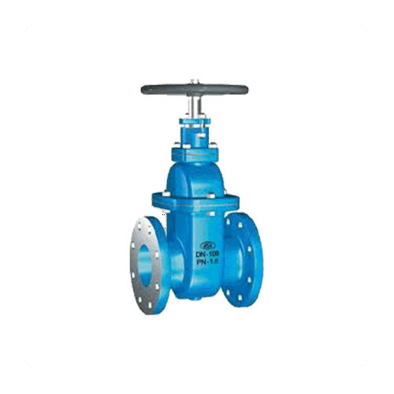
9.1.1 Sluice Valves
Most common type
Also known as gate valves or shut off valves of cutoff valves
Invariably provided at every point of intersection
May be used at intervals of 150 to 300m.
Should not be used in partly open position as the gates will erode rapidly
Source : www.indiamart.com/sluicevalves

Slide 7
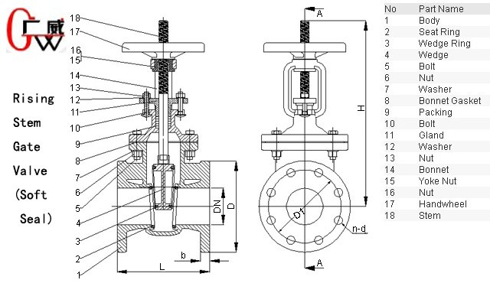
Working of Sluice Valve
.
Rotate anti clock wise
Water flows
Wedge /gate covers flow section
Rotate
Anti clockwise
Water doesn’t flow
Wedge/gate covers flow
section
Source : https://www.Alibaba.com/product-detail/sluice-valve_html

Slide 8
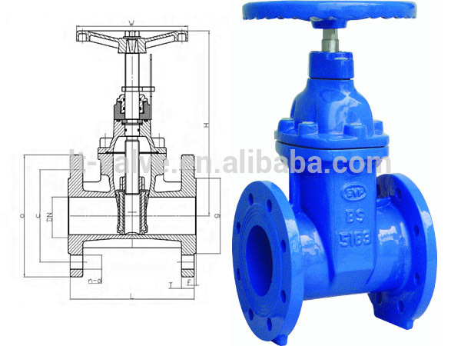
9.1.1 Sluice Valves
Available with threaded, flanged or spigot and socket ends.
Uses:
In distribution system to shut off the supplies whenever designed.
To isolate certain sections of the pipelines by closing the sluice valves at both ends thus by enabling repairs to be carried out.
Source : www.alibaba.com/sluice-valve

Slide 9
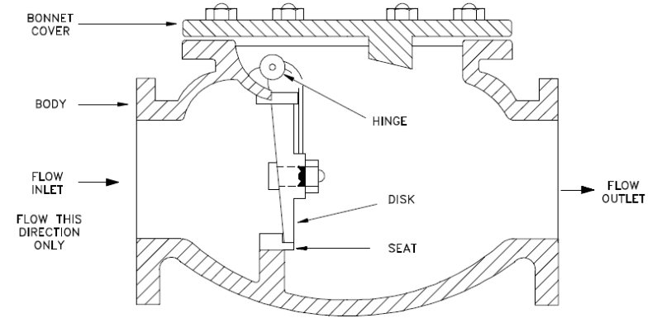
9.1.2 Reflux Valves
Also known as check valves or non return valves.
Allows flow in only one direction.
Place in pumping main to avoid backflow during pump failure.
Source : https://automationforum.co/check-valves/

Slide 10
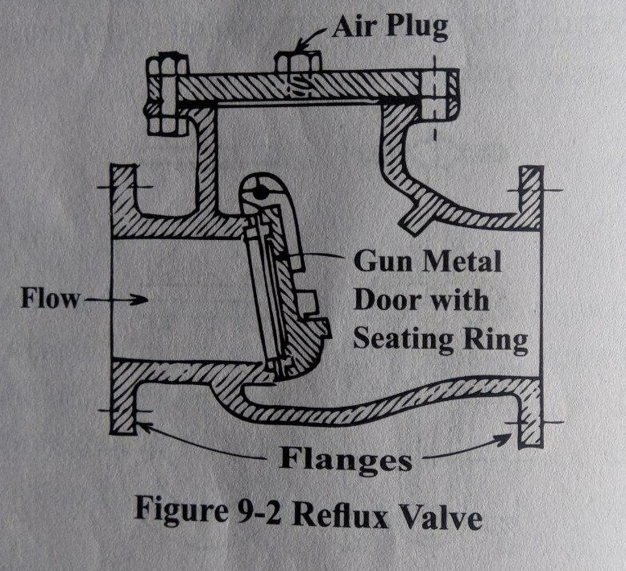
Working of Reflux Valve
Consists of gunmetal disc hinged at its top edge
Disc fits tightly against annular gunmetal seat under its self weight
With flow of water, disc rotates around the hinge and remains in horizontal plane. This lets water to pass through.
When flow of water stops, disc automatically falls down and hence prevents the back flow of water.

Slide 11
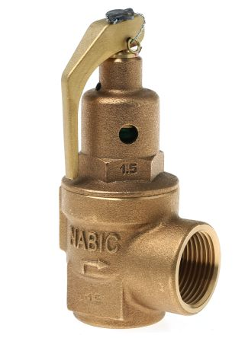
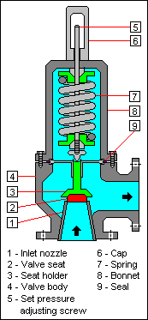
9.1.3 Pressure Relief Valve
Also known as automatic cutoff or safety valves.
Keeps the pressure in the pipeline below predetermined value.
Avoids the bursting due to high temperature.
At high pressure, allows water to flow out to the waste thereby reducing pressure in pipe.
Used where high pressure is more likely to take place.
Source : http://17.waste.agrotek-led.de/pressure-relief-valve-how-works.html

Slide 12
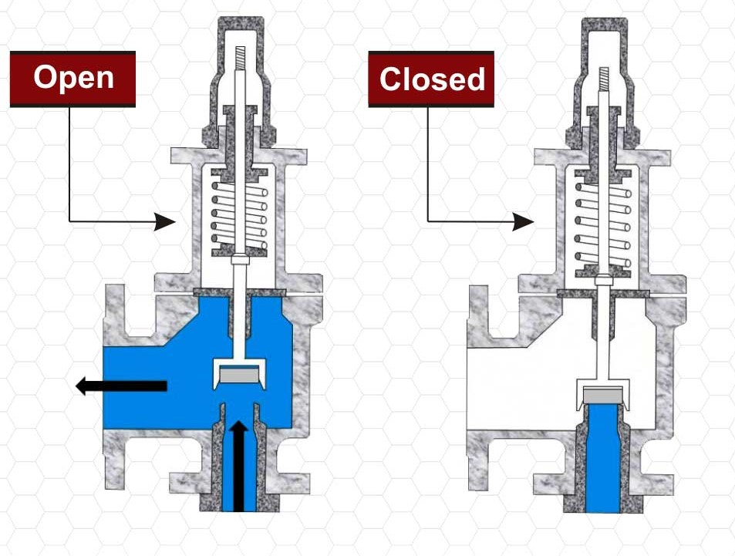
Working of Pressure Relief Valve
Consists of spring loaded disc, adjustable to desired pressure
When water pressure exceeds the adjusted valve, valve opens and water flows out as waste as in figure
Source: http://17.waste.agrotek-led.de/pressure-relief-valve-how-works.html

Slide 13
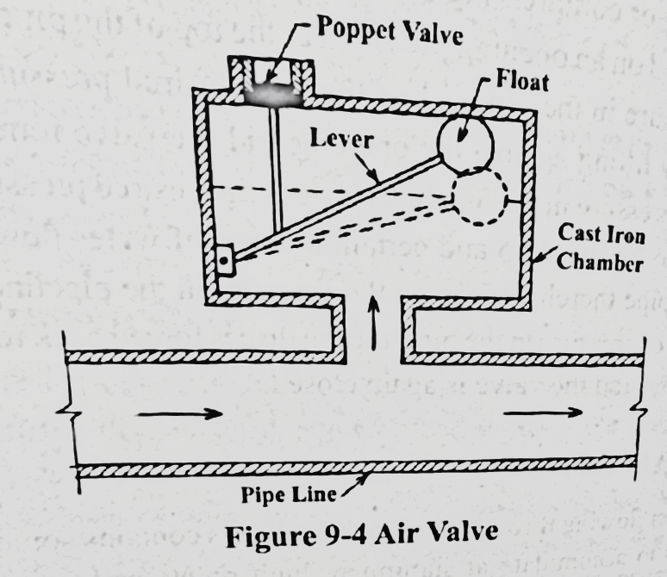
9.1.4 Air Valve
Also known as air relief valve
Provided at summit or high points in the pipeline to provide an exit for accumulated air
USES:
To release and admit air
Prevent from pressure falling below atmospheric

Slide 14
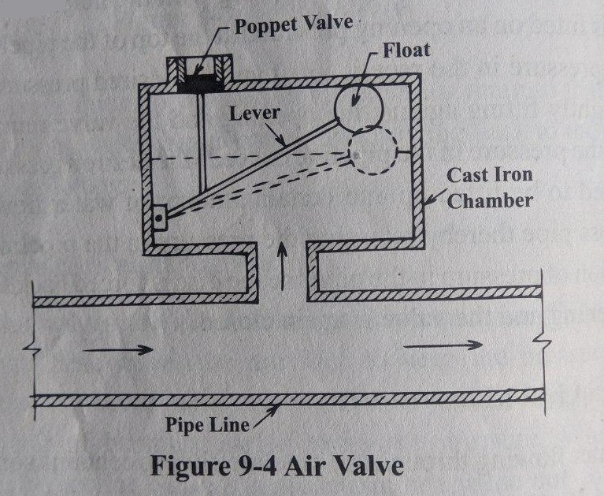
Working Of Air Valve
At normal condition, poppet valve is held in closed condition
When water level falls / air is entrapped, float lowers, poppet valve opens and air is released
When water rises, float is raised and poppet valve is closed again

Slide 15
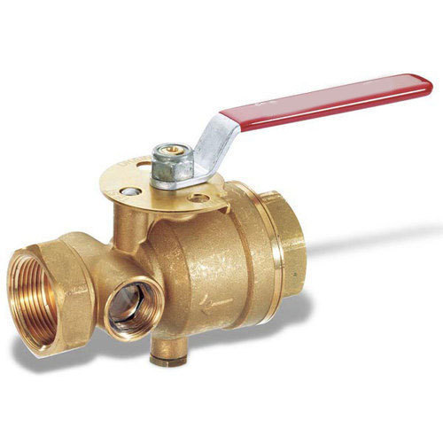
9.1.5 Drain Valves
Also known as scour or washout or blow off valves.
Are ordinary sluices for completely emptying pipeline or draining the pipe.
Located at dead ends or depression in the pipelines.
Operated manually.
Fig : drain valve
Source : indiamart.com

Slide 16
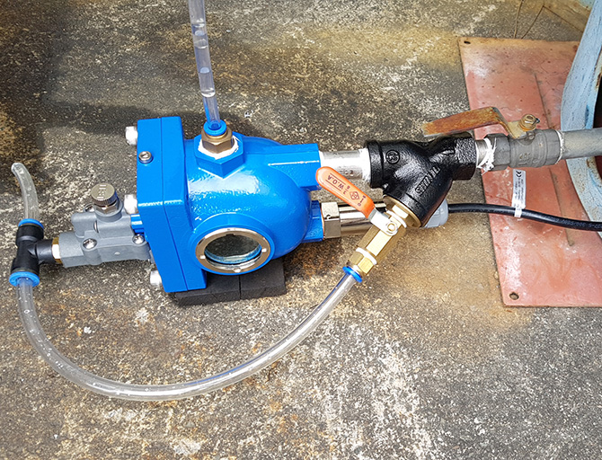
9.1.5 Drain Valves
Discharges into natural drainage or sewer or into sump from where water can be pumped to waste
Uses:
Useful in removing sediments from pipeline
Useful in repair works of pipeline
Source : acecorp.ltd

Slide 17
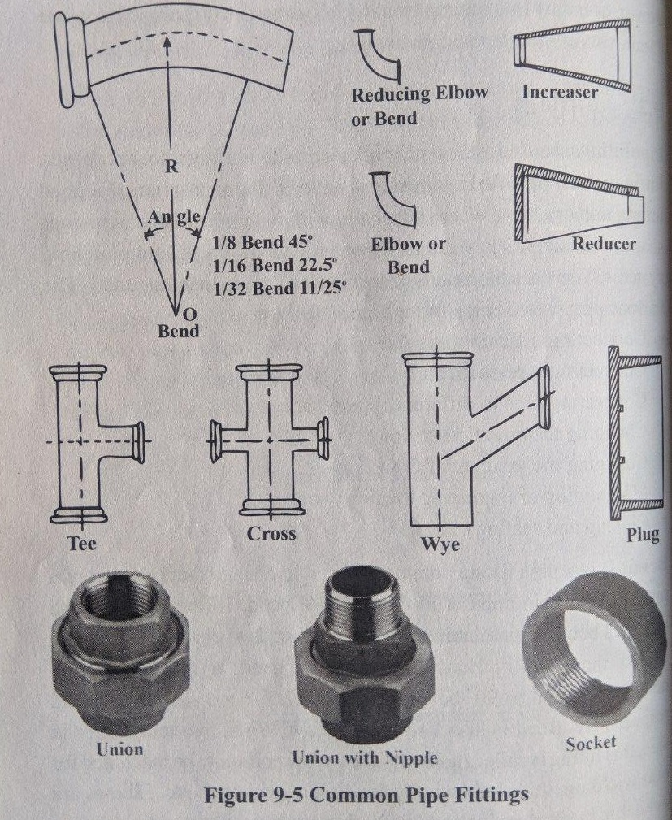
9.2 Fittings
Fittings are use during laying of pipes and allows pipes to joined or installed in appropriate place

Slide 18
Various use of pipe fittings
1
Connecting different pipes sizes and sections
2
Connecting pipe to different appurtenances
3
Changing the direction of flow
4
Changing gradient of flow
5
Maintaining and regulating the flow

Slide 19
Common Pipe Fittings
BEND
TEE AND WYE
NIPPLE AND UNION
PIPE FITTINGS
SOCKET
CROSS
PLUG
STOP COCK
REDUCER

Slide 20
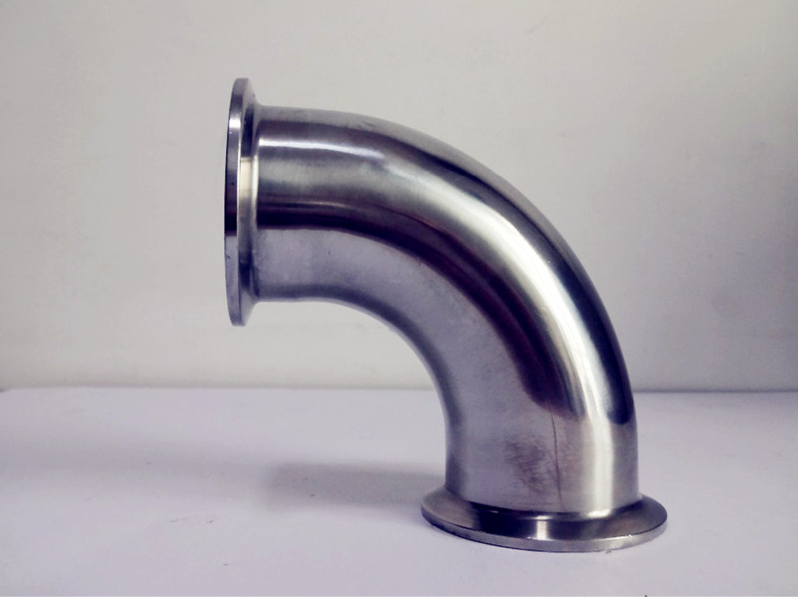
Bend
Commonly used to change the direction of a pipeline a certain number of degree.
Also known as elbow.
Elbows are available in short radius and long radius.
Short radius elbows have a center to end distance equal to its diameter.
Long radius elbows have a center to end distance of 1.5 times its diameter.
Source : www.indiamart.com

Slide 21
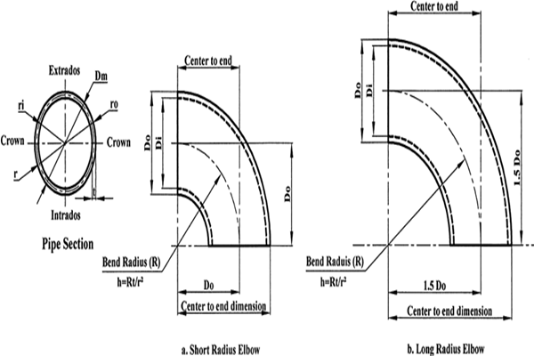
Source : https://www.Alibaba.com/product-detail/bend-valve

Slide 22
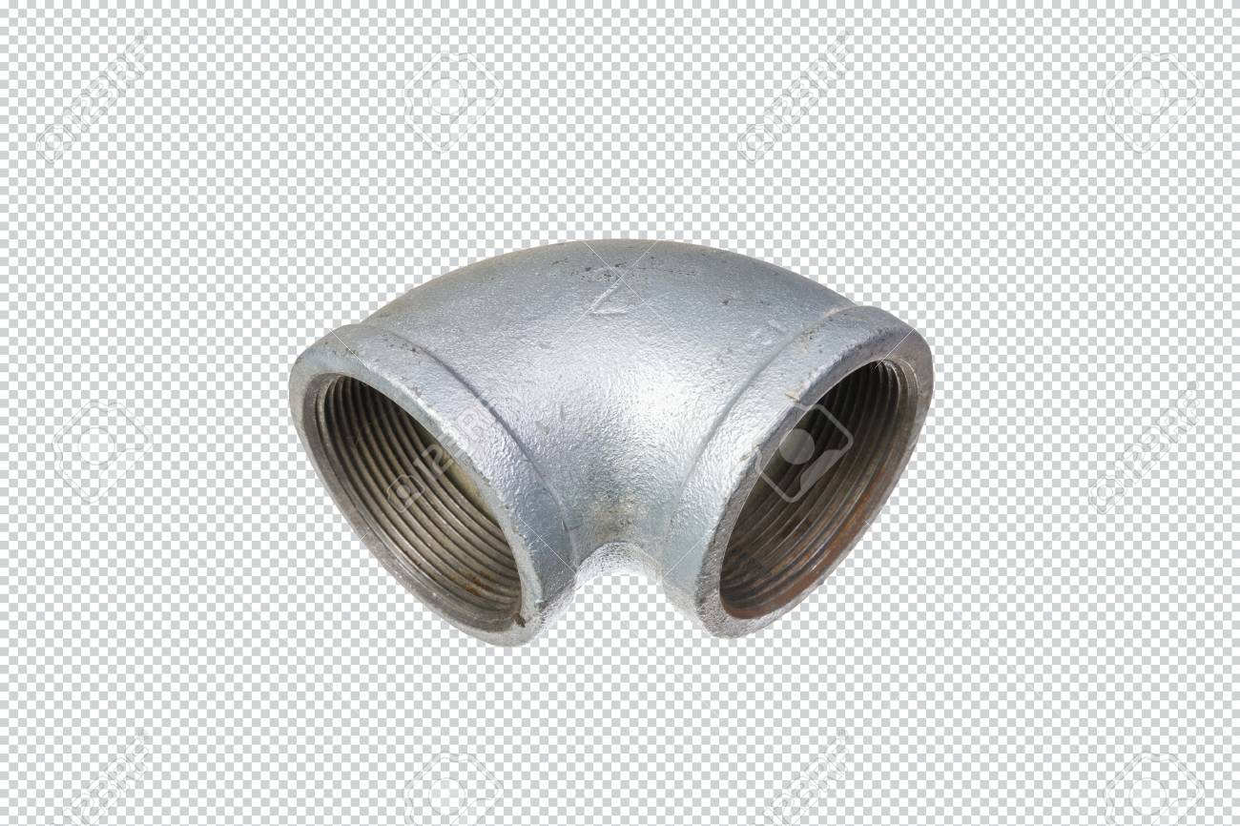
Bend
USES:
Used to change the direction of flow.
Short radius elbows used in the pressurized system.
Long radius elbows used in the gravity fed system where low turbulence and solids deposition are concern.
Source : www.Alibaba.com/bend-pipefititng

Slide 23
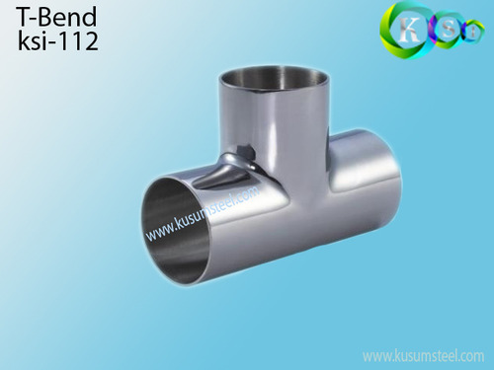
Tee
Most common pipe fitting
‘T’ shape having one inlet and two outlets.
Used for connecting pipes different diameter or for changing the direction of pipe runs.
Source : www.kusumsteel.com

Slide 24
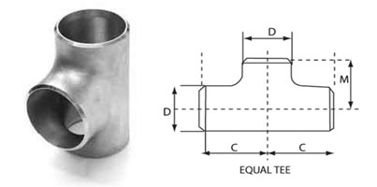
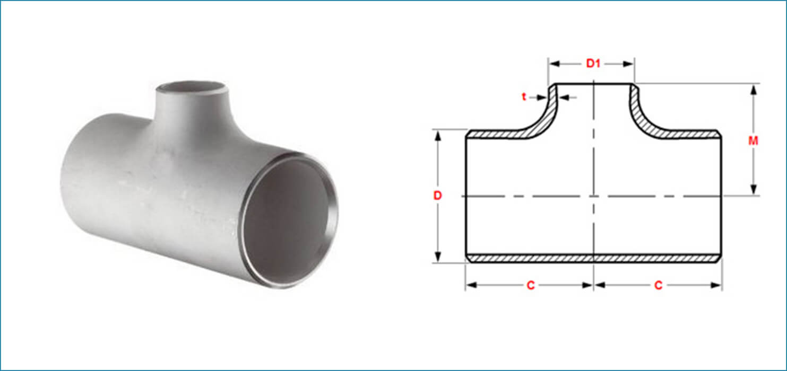
Tee Categorized as equal and unequal tee
Equal tee
Unequal tee
Used when size of branch is same as header pipe.
Used when size of branch is different than that of header size.

Slide 25
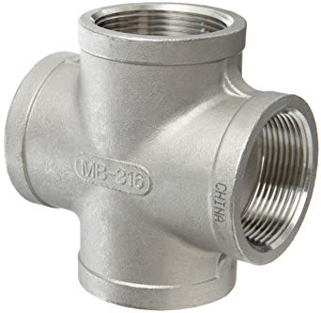
Cross
Connects four pipe section together
Also called 4-way fittings.
If a branch line passes completely through a tee, the fitting becomes a cross
Has one inlet and three outlets, or vice verse.
Often have solvent welded socket end or female threaded ends
Source : www.amazon.com

Slide 26
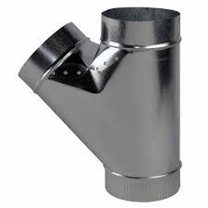
Wye
‘Y’ shaped fitting.
Fitting with three opening to create branch lines
Has one inlet and two outlets, or vice verse
Often have solvent welded socket ends or female threaded ends
Source : www.Alibaba.com/wye-fittings

Slide 27
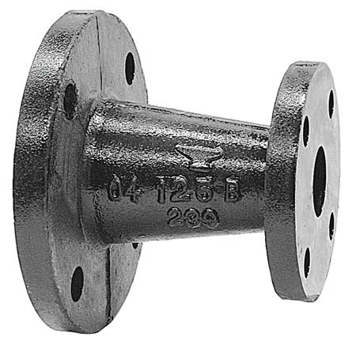
Reducer
Joins two pipes of different diameters to reduce of a pipe run
Allows for a change in pipe size to meet flow requirements of the systems.
When a reducer is reversed in direction, it allows increasing the diameter of a pip run and known as increaser.
Source : www.indiamart.com/reducer

Slide 28
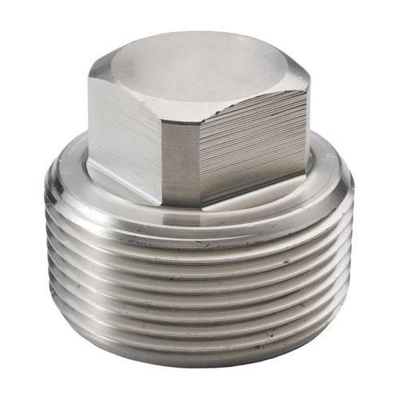
Plug
Closes off or seals the end of the pipe
Generally plug has male thread and fits inside the fitting it is mated to.
Similar to cap but cap has female thread.
Source : www.indiamart.com

Slide 29
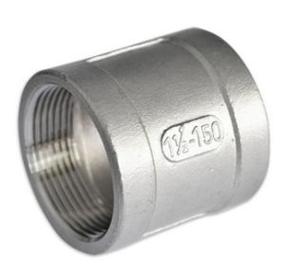
Socket
Female end or the hub of a fitting that fits over pipe
May be of two types which are plain socket and reducing socket.
Plain socket connects two pipes of same diameter.
Reducing socket connects two pipes of different diameters.
Source :www.made-in-china.com

Slide 30
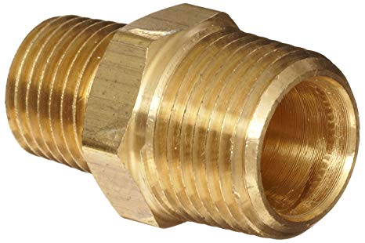
Nipple
Short tube of pipe which has external threads at each end.
Length usually specified by overall length with threads.
May have hexagonal section in the center for wrench to grasp known as hex nipple.
Also made from a short piece of pipe which is known as barrel nipple or pipe nipple.
Closed nipple has no unthreaded area when screwed very little nipple remains exposed.
Source: www.amazon.com/nipple

Slide 31
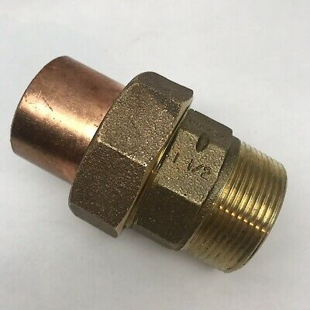
Union
Used to connect two pipes of same diameter which allows quick and convenient disconnection of pipes for maintenance or fixture replacement.
Provide a simple transition, allowing easy connection at any future time.
Standard union pipe is made in three parts consisting of a nut, female end, and a male end.
Source :www.ebay.com

Slide 32
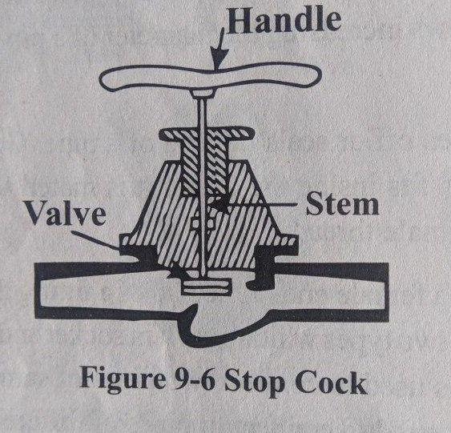
Stop Cock
Are practically sluice valves or gate valves of small size.
Provided on the pipelines leading to wash basins, water tanks, flushing tanks, etc. to stop or open the flow of water.
Also provided just outside the property boundary to isolate the building during maintenance.

Slide 33
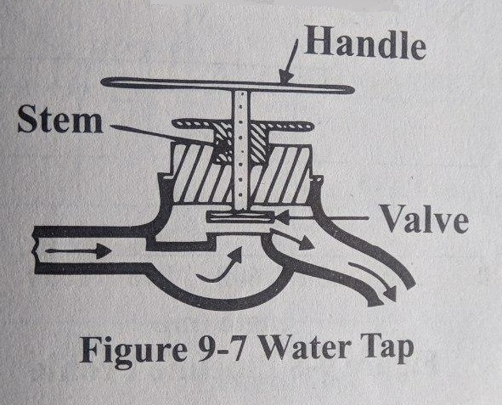
Water Tap
Also known as bib cocks or faucets.
Are fixed on the pipe line in wash basins, bathrooms, toilets, kitchens, etc. from where consumers obtained water.
Operated by a handle and the stem of the handle is threaded.
Valves inside the water can be moved up or down by turning the handle.
Clockwise turning of handle stops flow of water and vice verse.
Generally made of brass or gun metal or plastics.

Slide 34
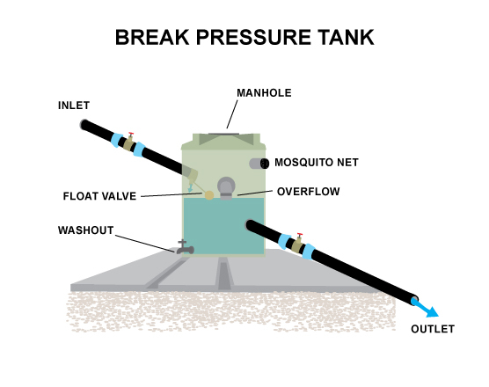
9.3 Break Pressure Tank (BPT)
[2]
Water tank or chamber with associated valve and fittings
Breaks the hydrostatic pressure in the pipeline system.
Establishes a new static water head.
[1]
Fig. Break Pressure Tank
[1] : Water Supply Engineering, Prof.Dr.Bhagwan Ratna Kansakar, First Edition, Pg. 337
[2] : https://littlebylittle.co/2018/08/27/wash-croix-rouge-francaise/
34

Slide 35
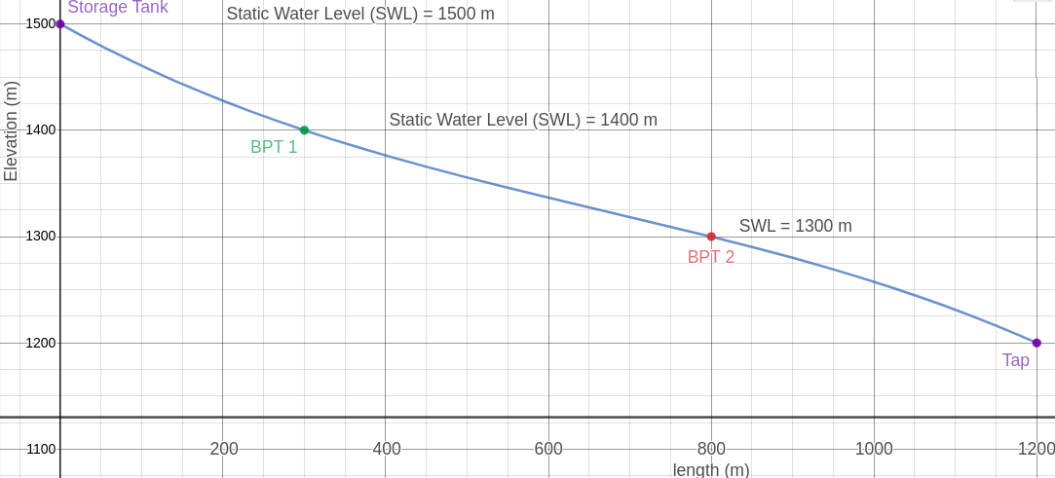
Significance of Break Pressure Tank
[2]
Control points in the water distribution system
Determines the design of pipe system
Determines discharge of the system
[1]
[1] : Water Supply Engineering, Prof.Dr.Bhagwan Ratna Kansakar, First Edition, Pg. 357
Graphing platform : www.desmos.com

Slide 36
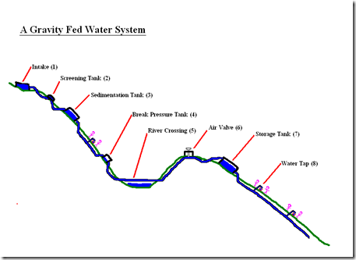
Strategic Placing Of BPT
The placing should be such that it
Addresses the gradient and change in slope
Addresses the location of community and its population
Minimizes the use of high pressure rated pipes
Optimizes the cost

Slide 37
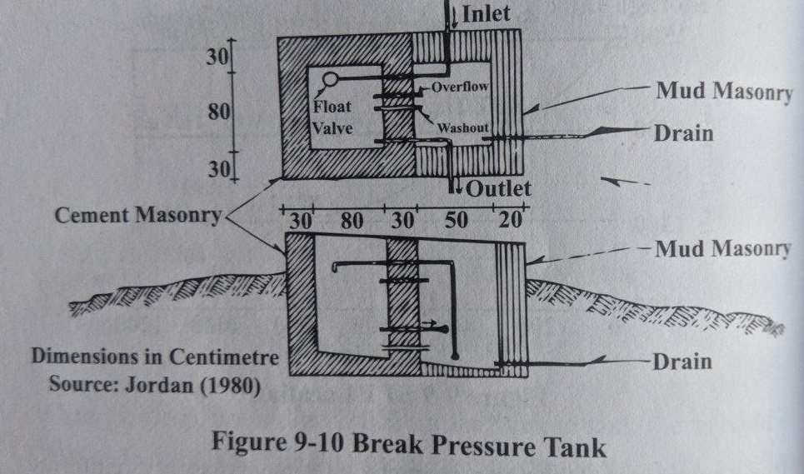
Construction of Break Pressure Tank
Cement Masonry or Reinforced Concrete structure
Excavation 30 cm into firm soil
A layer of gravel and masonry footing
Masonry walls 30 cm thick built of 1:4 cement sand mortar and plastered
Covered with CGS sheeting or a RCC slab
Proper drainage conditions for washout, overflow and rain run-off
Dimensions large enough to accommodate fittings and valves

Slide 38
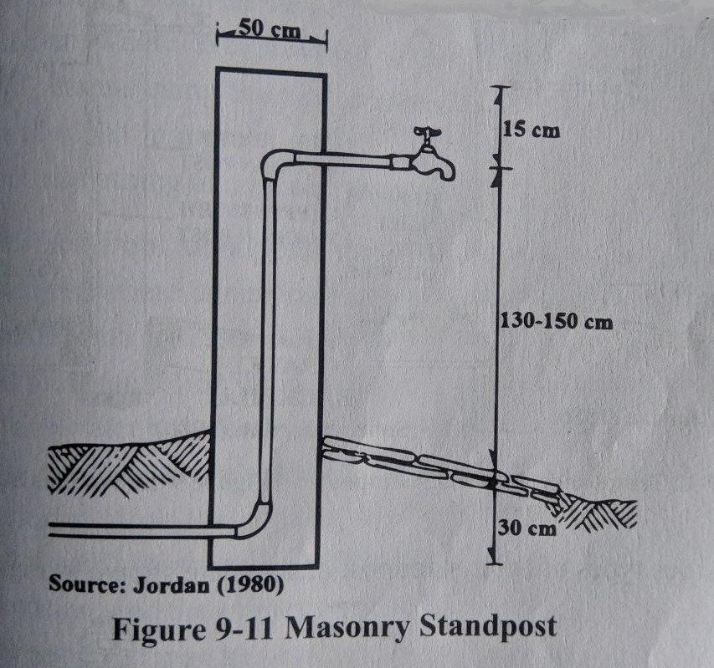
9.4 Public Standpost
[2]
[1]
Suitably supported water pipe
Terminates in a tap or faucet, which is located at a public place.
A gathering spot for people in Nepalese Society
Should be properly designed and built clean and attractive.
Fig. Public Stone Spout, Nepal
[1] [2]: Water Supply Engineering, Prof.Dr.Bhagwan Ratna Kansakar, First Edition, Pg. 337

Slide 39
Location of Public Stand post
Type of Walking Distance | Desirable | In Exceptional Cases
Horizontal | 150 | 250
Vertical | 50 | 80
A stand post should serve a maximum 100 users

Slide 40
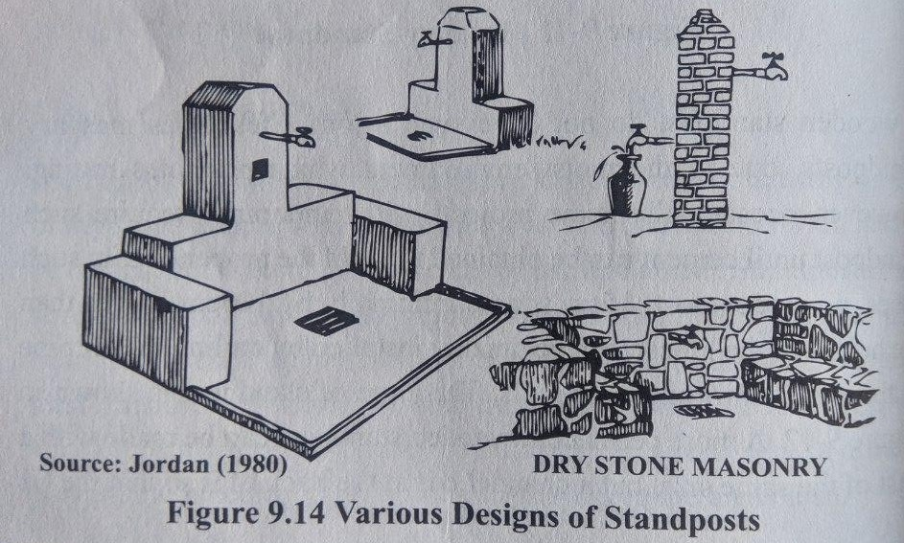
Flow
Standard stand post flow is 0.15 LPS.
Minimum flow is 0.1 LPS.
Residual Head
Recommended residual head at stand post
Absolute minimum: 5 meters
Most desirable: 15 meters
Absolute maximum: 56 metres

Slide 41
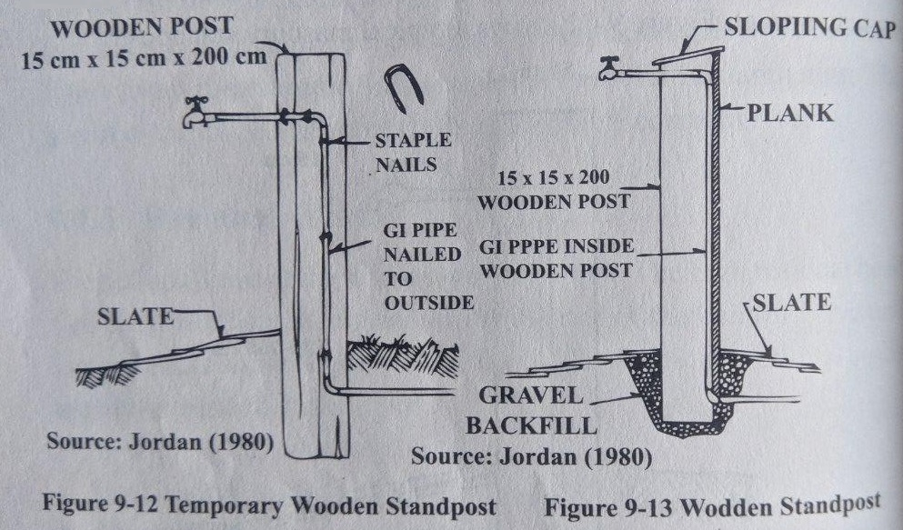
Construction
Constructed of brick, stone, or wood using mortar
Supporting column of 50 cm × 50 cm
15 mm mild steel riser pipe
Height of tap from ground = 1.3 – 1.5 m

Slide 42
Maintenance of Water Supply System
[1]
Provides sustainable, equitables, consistent, economic safe and adequate water over the design period
Ensures effective routines running of system timely and daily.
Protects and maintains structural system associated with distribution of water
[1] : https://www.pas.org.in/Portal/document/ResourcesFiles/pdfs

Slide 43
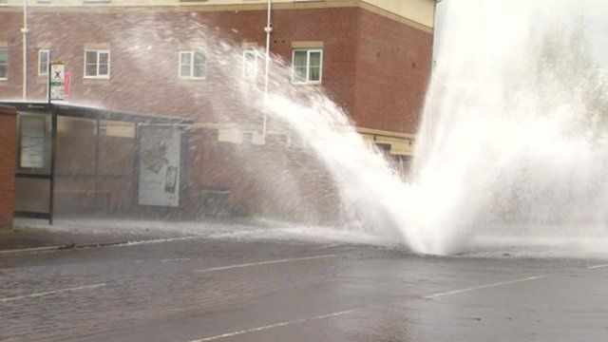
Consequences of Poor Management
[1]
Another flaw in the human character is that everybody wants to build and nobody wants to do maintenance.
Kurt Vonnegut
[2]
[1] : https://www.bbc.com/news/av/uk-england-tyne-17956839/gateshead-burst-water-pipe-causes-fountain
[2] : http://www.wiseoldsayings.com/maintenance-quotes/

Slide 44
Methods of Maitenance
Preventive Measures
Regular inspection
Minor repairs and replacement
Corrective Measures
Major Replacement and Repairment
Reallocation of pipe route
Reactive Measure
Solving user problems
Replacement of pipe.
[1]
[1] : Water Supply Engineering, Prof.Dr.Bhagwan Ratna Kansakar, First Edition, Pg. 337

Slide 45
QUERIES AND FEEDBACK SESSION

